Slide 1
BUSINESS STORY · RETAIL ANALYTICS
NeoMart Retail
Performance Analysis
Evaluating sales trends, profitability, customer satisfaction, and delivery performance to guide NeoMart's next strategic moves.
Prepared for Management Review

Slide 2
EXECUTIVE SUMMARY
A strong year with clear operational gaps
NeoMart evaluated a full year of transactional retail data covering sales, profitability, customer satisfaction, and delivery operations. The business achieved strong overall sales — led by the South region and a powerful Q4 finish — with Electronics as the standout profit driver. However, heavier discounting eroded margins, and the South region's operational strain (slow deliveries, inconsistent service) is undercutting the value of its own sales lead. Addressing discount discipline, South region logistics, and East region growth are the clearest paths to improved performance.
201K
-0.45
Peak monthly sales, December
Discount vs. Profit correlation
7.7 days
3.2 / 5
Median South delivery time
Median South satisfaction score
South leads sales, but trails on delivery speed & satisfaction
Electronics is the profit engine; Furniture lags
East region is the clearest growth opportunity
Section 1 · Overview
NeoMart Retail Performance Analysis

Slide 3
SITUATION & COMPLICATION
Why we looked, and what we found
Volatile monthly sales
SITUATION
A sharp Jan→Feb drop, a June-July dip, then a steady climb to a December peak — pointing to seasonal and promotional swings.
NeoMart analyzed its retail sales data to evaluate performance across regions and product categories — covering sales trends, profitability drivers, customer satisfaction, delivery performance, and the impact of discounting on profit.
Regional imbalance
South leads total sales by a wide margin; East trails all regions.
Uneven product profit
Electronics drives the most profit; Furniture contributes the least.
The goal: give management the evidence needed to improve profitability, customer experience, and operational efficiency.
Discounting hurts margin
A moderate negative correlation (r = -0.45) links bigger discounts to lower profit.
South's service strain
Longest delivery times and lowest, most inconsistent satisfaction scores — despite leading in sales.
Section 2 · Business Context
NeoMart Retail Performance Analysis

Slide 4
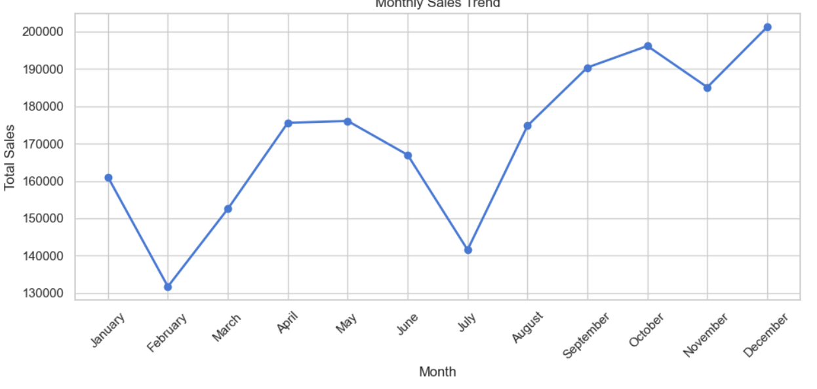
KEY FINDING · SALES TREND
Sales swing hard early in the year, then climb to a December peak
LOWEST POINT
February — a steep drop from January's 161K.
MID-YEAR DIP
Sales soften again in June-July before recovering.
STRONGEST CLOSE
December hits the year's high at ~201K, capping a steady Aug-Dec climb.
Section 3 · Key Findings
NeoMart Retail Performance Analysis

Slide 5
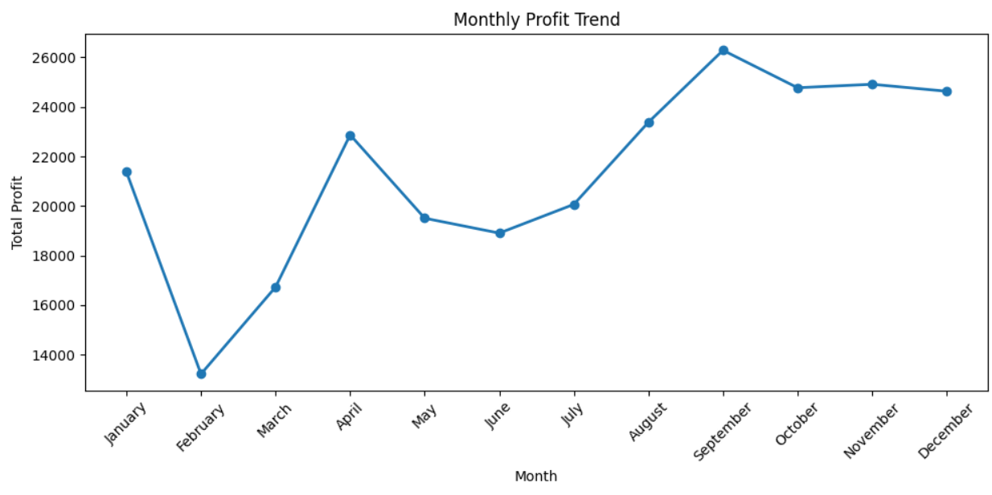
KEY FINDING · PROFIT TREND
Profit follows a similar arc, peaking in September
LOWEST POINT
February profit bottoms out near 13.2K, mirroring the sales dip.
SHARP REBOUND
April jumps to ~22.9K before a mid-year cooldown in May-June.
BEST QUARTER
September peaks at ~26.3K; Q4 holds steady around 24.5-25K.
Section 3 · Key Findings
NeoMart Retail Performance Analysis

Slide 6
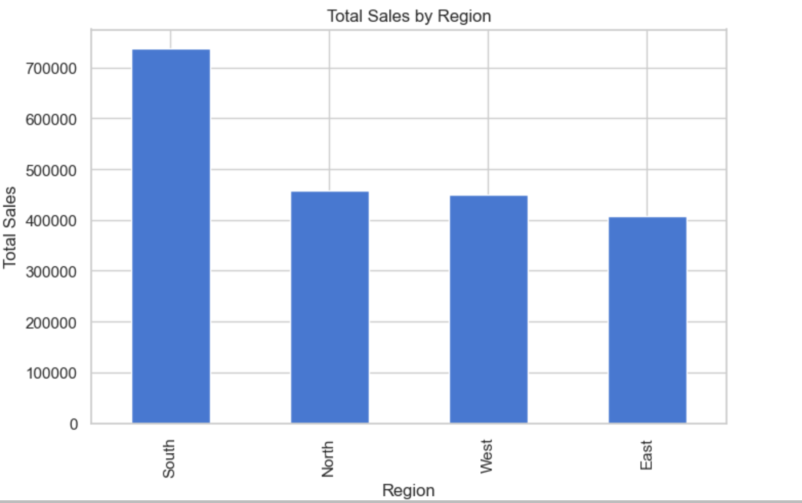
KEY FINDING · REGIONAL PERFORMANCE
South drives sales — but not evenly across the country
South
Highest
~735K
North
~457K
West
~449K
East
Lowest
~406K
Section 3 · Key Findings
NeoMart Retail Performance Analysis

Slide 7
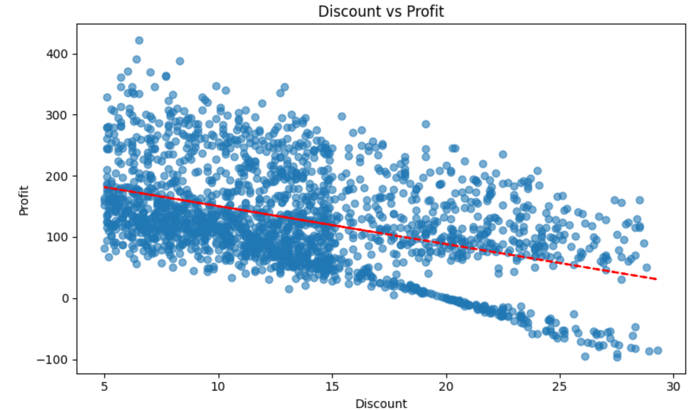
KEY FINDING · DISCOUNT ANALYSIS
Bigger discounts, smaller profits
r = -0.45
Moderate negative correlation between Discount and Profit
The downward trend line shows profit consistently falling as discount rates rise. A cluster of heavily-discounted orders (bottom-right) even slips into negative profit — suggesting some promotions are sold at a loss.
Section 3 · Key Findings
NeoMart Retail Performance Analysis

Slide 8
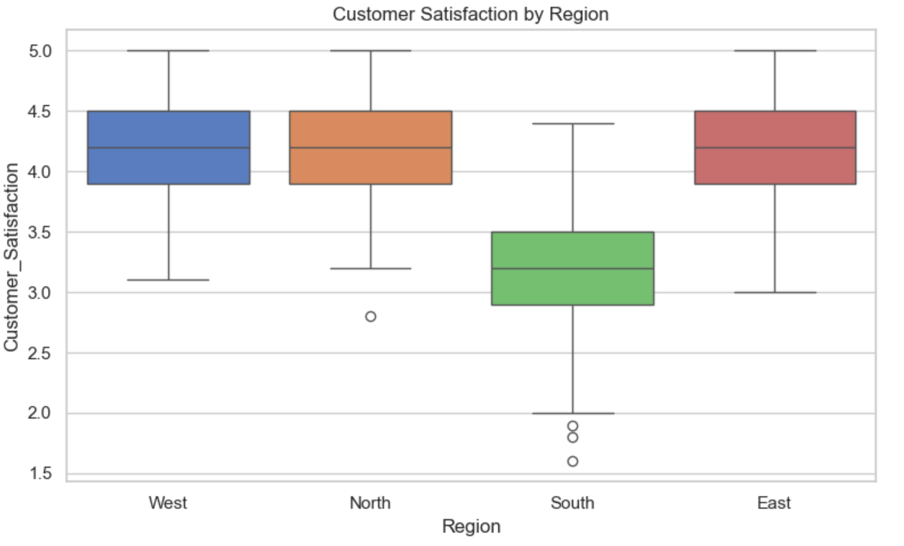
KEY FINDING · CUSTOMER EXPERIENCE
South customers are less satisfied — and less consistently served
WEST · NORTH · EAST
Median satisfaction ~4.2/5, tight and consistent scores
SOUTH
Median drops to ~3.2/5 with wide variability and low-rating outliers down to 1.6
Inconsistent service in the South is dragging down an otherwise strong satisfaction picture nationally.
Section 3 · Key Findings
NeoMart Retail Performance Analysis

Slide 9
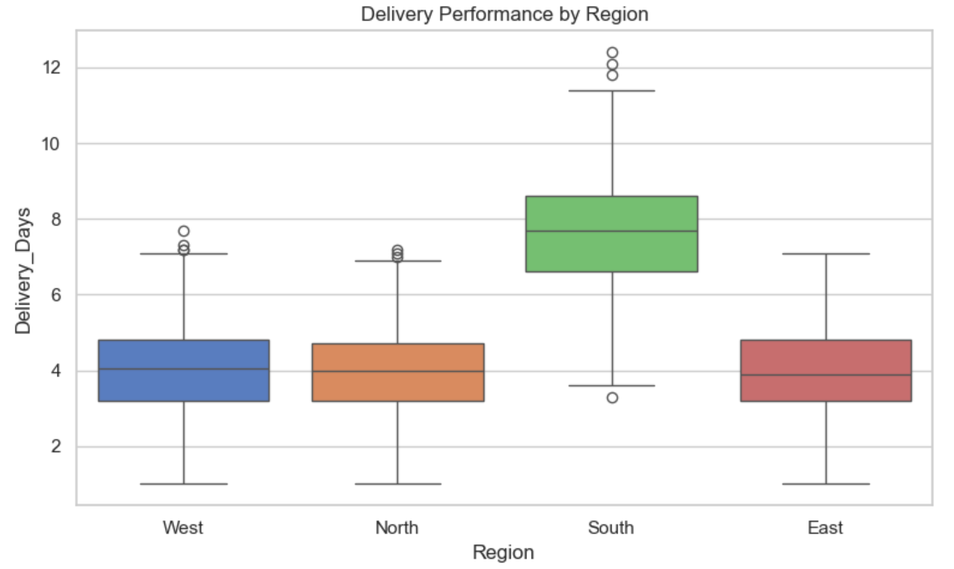
KEY FINDING · DELIVERY PERFORMANCE
South deliveries take nearly twice as long as everywhere else
~7.7 days
Median delivery time in the South, vs. ~4 days elsewhere
The South also shows the widest spread and several outlier deliveries stretching past 11-12 days — a likely root cause of the region's lower satisfaction scores.
Section 3 · Key Findings
NeoMart Retail Performance Analysis

Slide 10
DEEPER ANALYSIS
How the metrics move together
0.99
-0.45
-0.64
SALES ↔ COST
DISCOUNT ↔ PROFIT
DISCOUNT ↔ SATISFACTION
Sales rise alongside cost of goods sold — expected as more units move.
Higher discounts are associated with lower profits.
Bigger discounts coincide with lower customer satisfaction.
0.65
-0.62
0.29
DISCOUNT ↔ DELIVERY DAYS
SATISFACTION ↔ DELIVERY DAYS
PROFIT ↔ SATISFACTION
Higher-discount orders tend to take longer to deliver.
Slower deliveries track with lower satisfaction.
A weak positive link — more profitable orders skew slightly happier.
Section 4 · Correlation Analysis
NeoMart Retail Performance Analysis

Slide 11
SUMMARY
What the data tells us, at a glance
📈
🗺️
💰
Sales Trend
Regional Performance
Product Profitability
Volatile early, but a strong Aug-Dec recovery pushed December to the year's peak.
South leads on revenue; East lags and needs demand-building.
Electronics is the top earner; Furniture trails the pack.
🏷️
😊
🚚
Discount Impact
Customer Satisfaction
Delivery Performance
Heavier discounting is measurably eroding profit margins.
Strong and steady outside the South, which lags noticeably.
South's slow, inconsistent delivery times are the likely satisfaction culprit.
Section 3 · Key Findings
NeoMart Retail Performance Analysis

Slide 12
RESOLUTION
Five moves to turn insight into performance
01
Review the Discount Strategy
Cut unnecessary discounting; shift to targeted promotions that protect margin while still driving sales.
02
Fix South Region Delivery
Audit logistics, warehousing, and transport to close the delivery-time gap and lift satisfaction.
03
Grow the East Region
Launch targeted marketing and engagement campaigns to build market penetration and revenue.
04
Double Down on High-Profit Products
Keep Electronics as a strategic priority; investigate Furniture's pricing, costs, and inventory.
05
Monitor Satisfaction Continuously
Track feedback regularly and give extra support to lower-scoring regions before issues compound.
Section 5 · Recommendations
NeoMart Retail Performance Analysis

Slide 13
The Path Forward
Balanced discounting, faster South region delivery, and focused East region growth will help NeoMart turn a strong sales year into stronger, more consistent profitability.
Thank you

